Slide 1
Unsupervised Feature Learning For Urban Sound Classification
Justin Salamon
Juan Pablo Bello
New York University
Presented by Joseph Chiou

Slide 2
Dataset
Created by Justin Salamon & Christopher Jacoby & Juan Pablo Bello
Contains 8732 labeled sounds of real field-recording urban sounds from 10 classes : (1).air conditioner, (2).car horn, (3).children playing, (4). Dog bark, (5). Drilling, (6). Engine idling, (7). Jackhammer, (8) gun shot, (9) siren, and (10.) street music.
The largest free urban sound dataset.

Slide 3
Background
Limit of urban environmental sound classification
(ex. Air conditioner sounds)
Lacking the high-level structure observed in other domains such as speech and music
Notes:
Their sound can be masked by noise

Slide 4
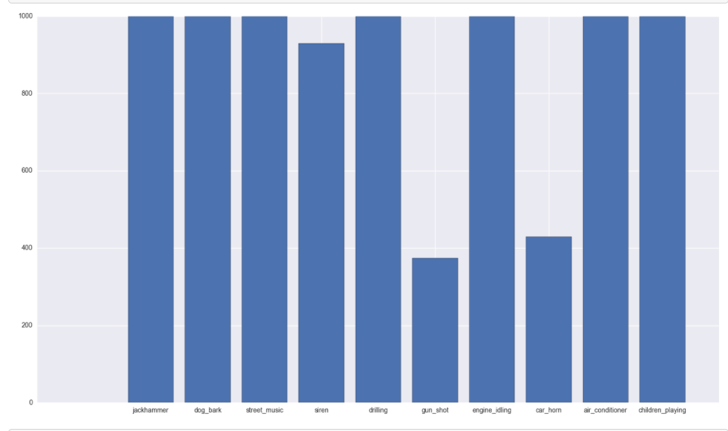
Sound distribution

Slide 5
Idea
Temporal dynamic can be a key role in classifying urban sound sources
Grouping several consecutive frames in order to learn features that take into account temporal dynamics
particularly interesting for urban noise-like sounds such as idling engines or jackhammers, where the temporal dynamics could potentially improve our ability to distinguish sounds whose instantaneous features (i.e. a single frame) can be very similar.
Notes:
Grouping several consecutive frames (by concatenating them into a single larger vector prior to PCA whitening), also known as shingling, allows us to learn features that take into account temporal dynamics. This option is particularly interesting for urban noise-like sounds such as idling engines or jackhammers, where the temporal dynamics could potentially improve our ability to distinguish sounds whose instantaneous features (i.e. a single frame) can be very similar.

Slide 6
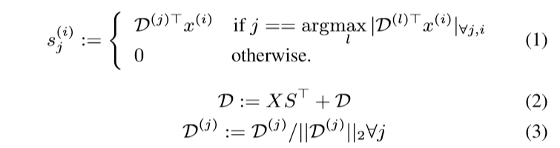
Notes:
(1) The assignment takes the value of the inner product or 0, not 1 or 0 as in regular k-means.
(2) recomputes the centroids
(3) Normalized the centroids by
Normal k means:
Euclidean distance
SKM:
- Cosine

Slide 7
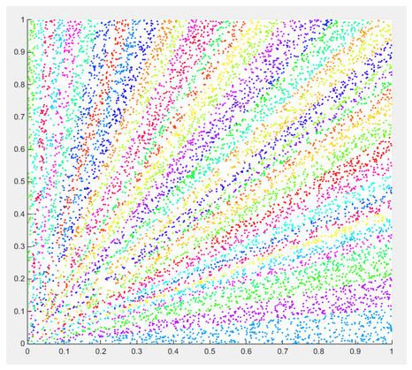

Slide 8
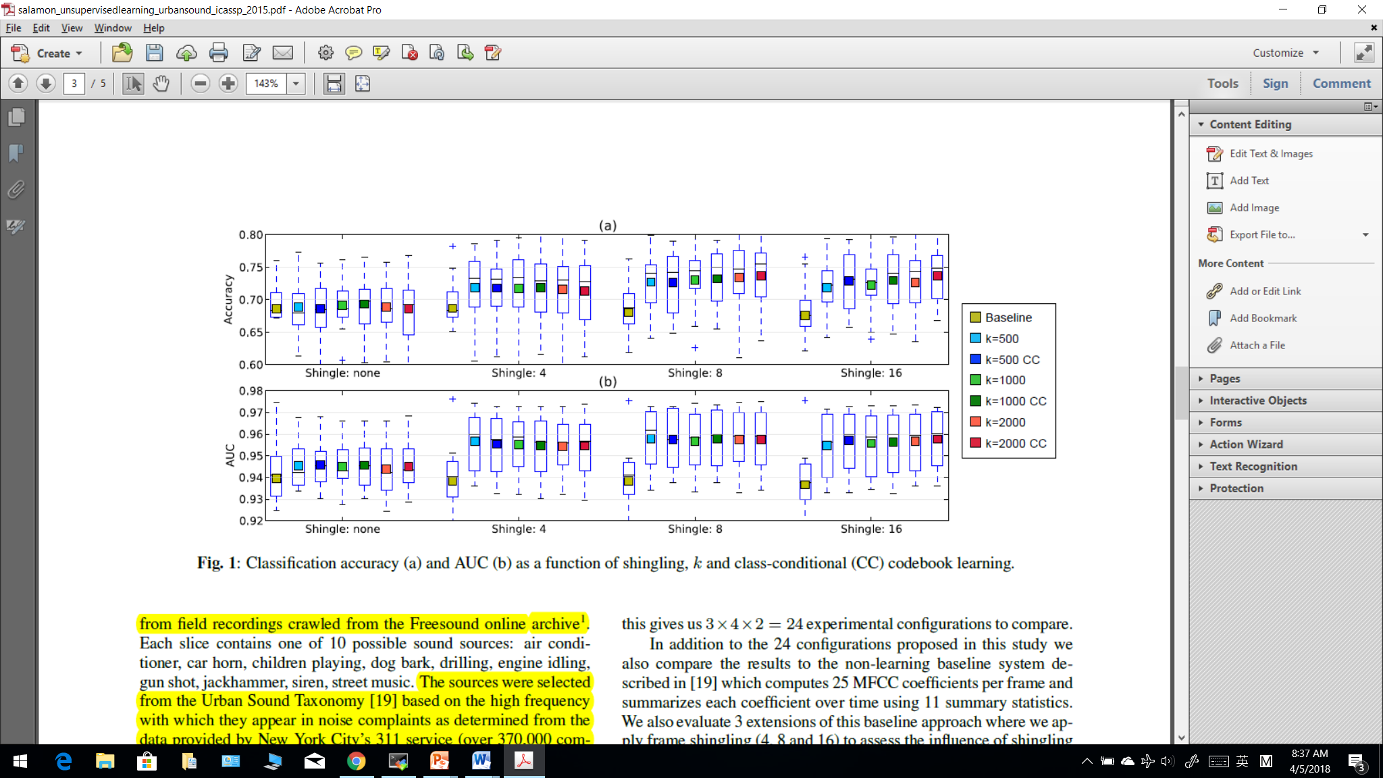

Slide 9
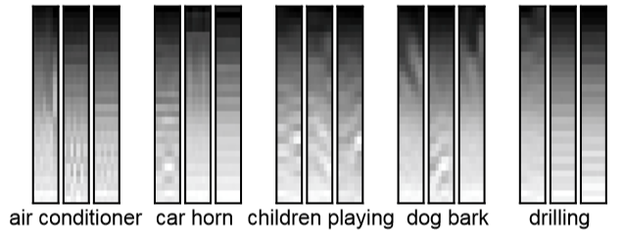
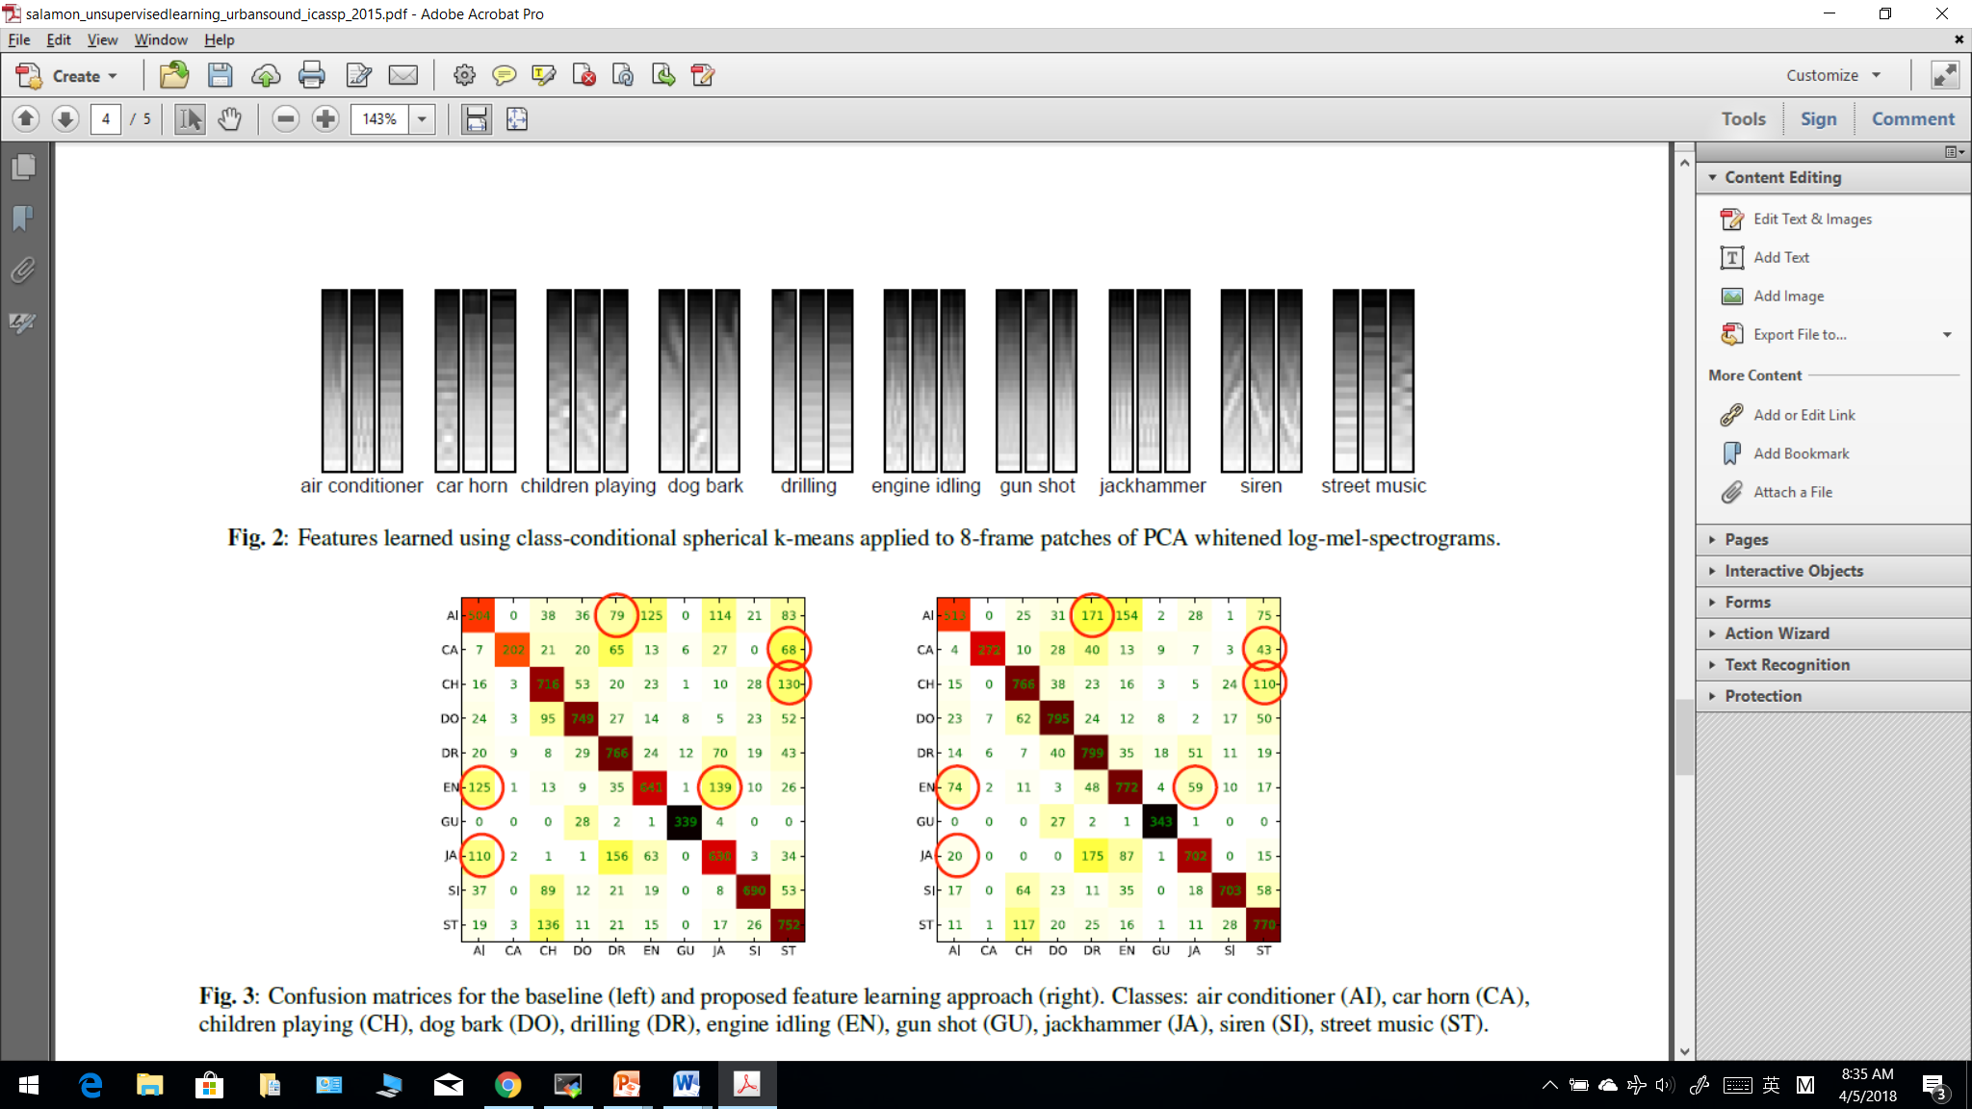

Slide 10
Baseline confusion matrix

Slide 11
Feature learning approach confusion matrix

Slide 12
Thank you

Slide 13
Urban Sound Classification
Joseph Chiou

Slide 14
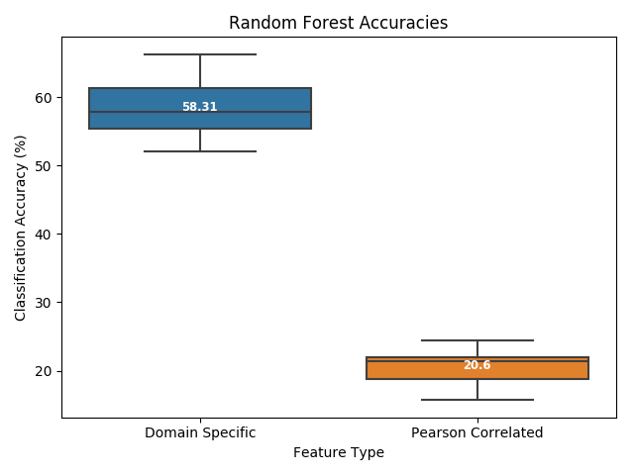
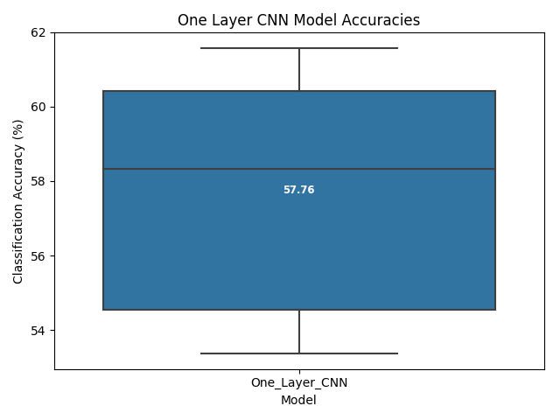
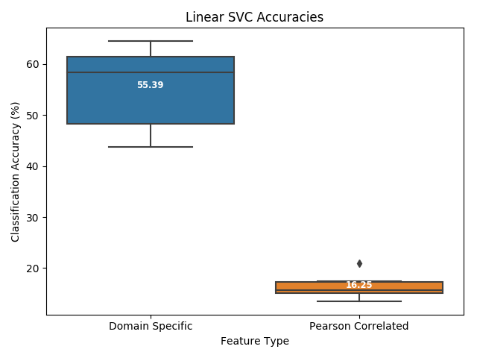
Notes:
SVM – based on first 193 features using Pearson Correlation
Avg accuracy: 16.25%
Run time: 1 sec
Accuracy on Fold 10: 17.29% (highest acc on Fold 3 – 20.98%)
- highest acc class: Dog bark (33%)
RF – based on first 193 features using Pearson Correlation
Avg accuracy: 20.6%
Run time: 4:25
Accuracy on Fold 10: 24.41% (highest acc across all fold)
- highest acc class: Dog bark (57%)

Slide 15
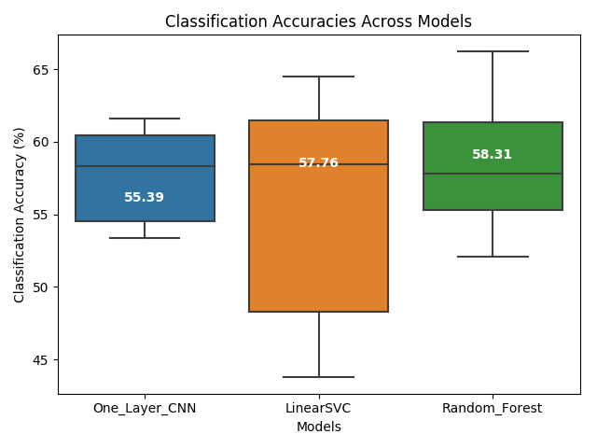
Accuracy Overviews

Slide 16
One layer CNN
128 x 128 x 2
Epoch: 20
90/10 validation. Use Fold 10 for testing, and Fold 9 to validate.
10 fold cross validation
Avg accuracy: 60.53%
Most predictive class: Gun shot (100%)
Run time: 1:02:11
Notes:
Least predictive classes: Air conditioner (37%) Siren (44%)
Mean accuracy of different test fold: 57.76%
2 dense layer

Slide 17
CNN Structure
Convolutional layer: 24 filters with receptive field (5,5)
Pool layer: Max pooling (4,2)
Rectified linear unit (ReLU) activation: h(x)=max(x,0)

Slide 18
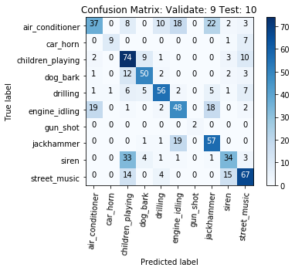

Slide 20
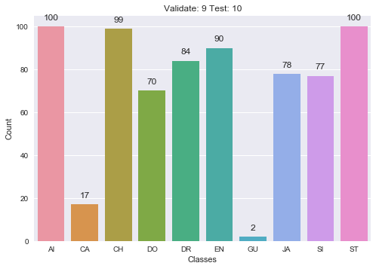
Samples distribution in Fold 10
GU only has 2 samples being considered
Notes:
(32?)
In order to create a 128 frame the window size is 65024 samples/mms
Window size = hop size * (frame -1) →512 * 127
# samples between each successive fast fourier transform
Window size smaller than this # is not considered.

Slide 21
SVM
C value = 0.01
10 fold cross validation. 90/10 validation on Fold 10
Accuracy: 62.49%
Most predictive classes: Gun shot (85%)
Run time: 2:05
Notes:
Avg accuracy across all testing fold: 55.4% (test fold 2, 3, and 6 below 50%, test fold 4, 5, 9, and 10 higher than 60%)
Gun shot has high% but it also has sig less samples than other class (32)

Slide 22
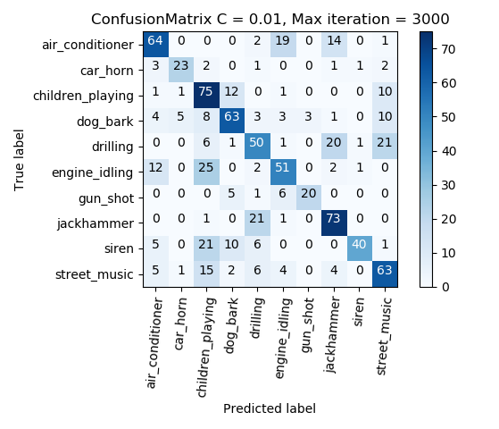

Slide 23
Random Forest
Tree: 500
Depth: 6
90/10 validation on Fold 10
Accuracy: 61.29%
Most predictive class: Children playing (82%)
Run time: 4:54
Notes:
Dr. Roshan’s variable: tree 100, depth 6
Avg accuracy: 58.89% (100 runs avg)

Slide 24
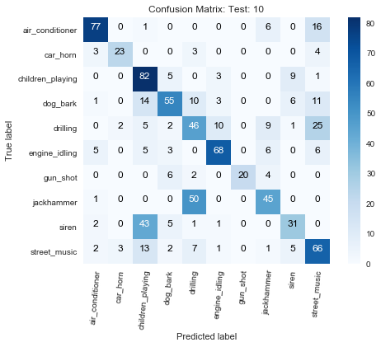

Slide 25
Thank you

Slide 26
Comparison
CNN RF SVM

Slide 27
Accuracy of each sound type
Sound Type | CNN | RF | SVM
Air Conditioner | 0.37 | 0.77 | 0.61
Car Horn | 0.53 | 0.7 | 0.7
Children Playing | 0.75 | 0.82 | 0.53
Dog Bark | 0.71 | 0.55 | 0.62
Drilling | 0.67 | 0.46 | 0.54
Engine Idling | 0.53 | 0.73 | 0.62
Gun Shot | 1 | 0.62 | 0.85
Jackhammer | 0.73 | 0.47 | 0.64
Siren | 0.44 | 0.37 | 0.75
Street Music | 0.67 | 0.66 | 0.62
CNN performs better on identifying noise sound

Slide 28
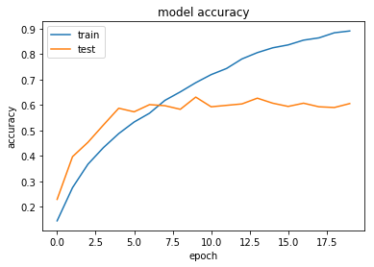
Model accuracy vs epoch
Accuracy stays around 0.6 after 10 epoch

